Slide 1

RISC-V SoC for Computer Vision Applications
Tutorial 1: AND Gate on IGLOO2 FPGA Using Libero SoC IDE
EE 297
Friday, December 17, 2020
Project Members:
Anee Mineshkumar Dubhia^{[1]}
Chee Vang^{[2]}
Advisor:
Professor Harry Li, Ph. D.^{[3]}

Slide 2

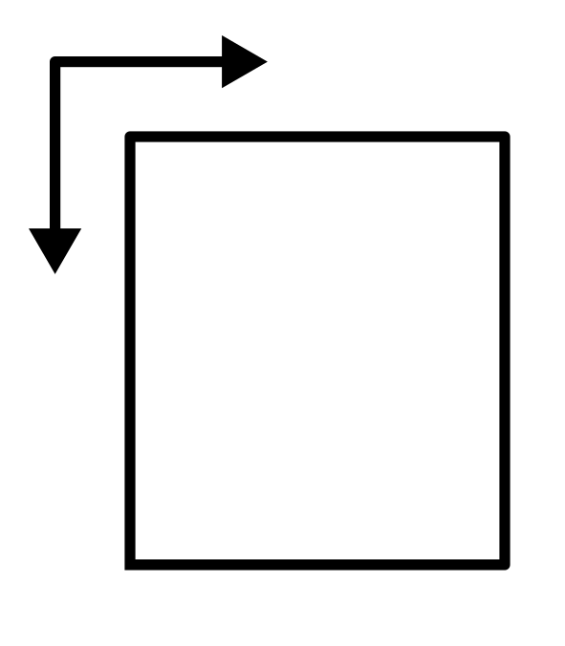
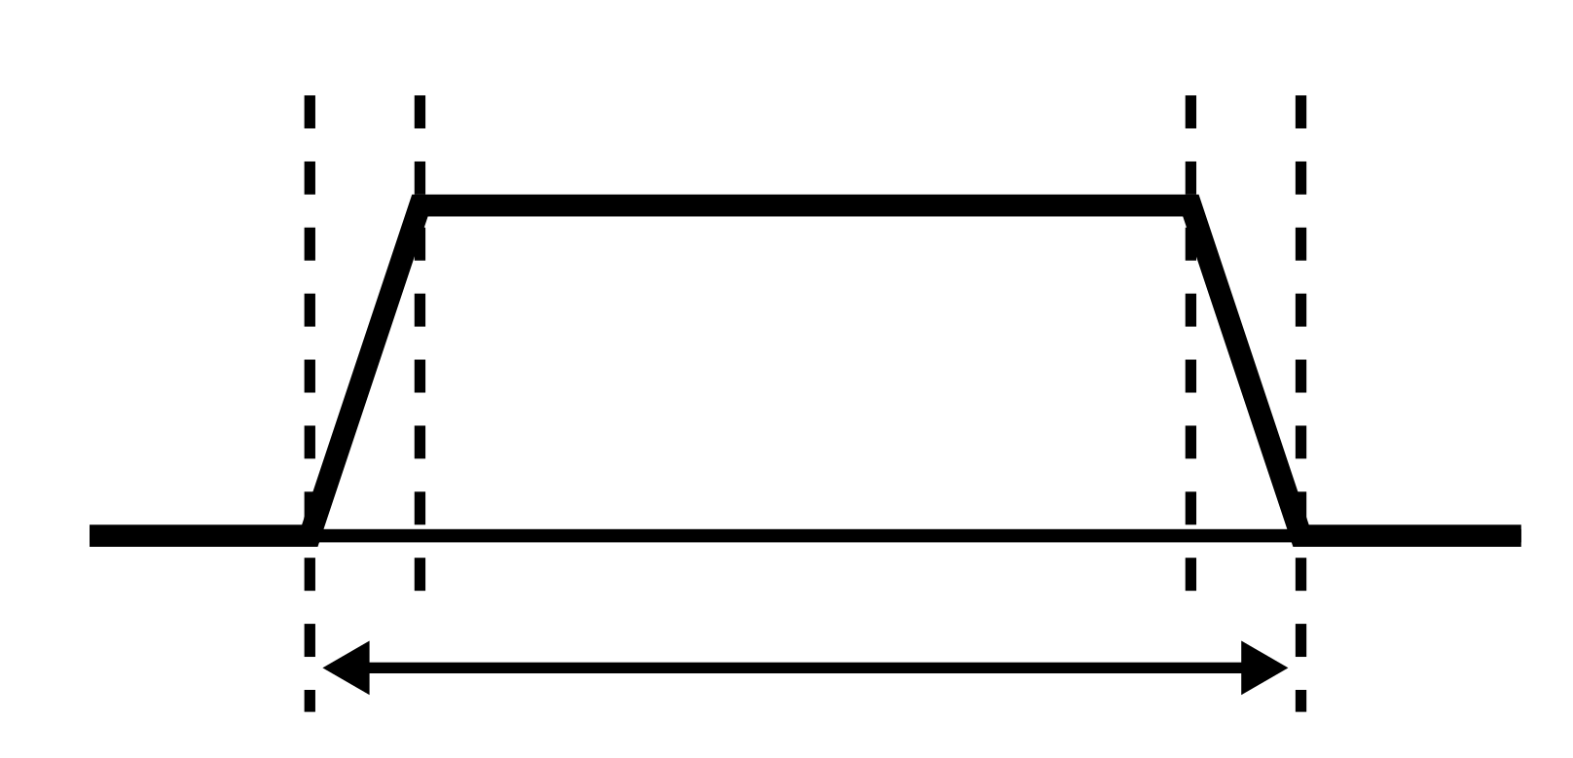

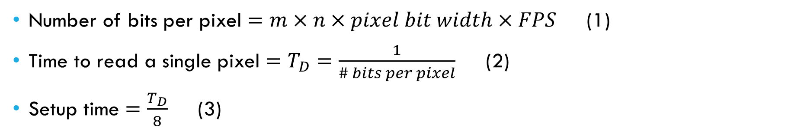
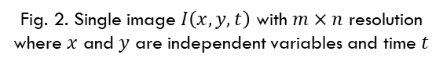
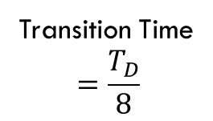
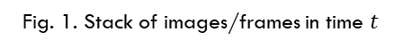
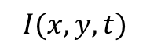

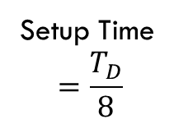
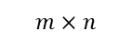
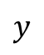

Timing Required To Display a Pixel
$$x$$
Setup Time
$$=\frac{T_{D}}{8}$$
Transition Time
$$=\frac{T_{D}}{8}$$
0
$$y$$
0
$$I(x, y, t)$$
$$t$$
$$m×n$$
Fig. 2. Single image $I\left(x,y,t\right)$ with $m×n$ resolution where $x$ and $y$ are independent variables and time $t$
Fig. 1. Stack of images/frames in time $t$
$$T_{D}$$
Fig. 3. Timing waveform for setup and transition time
Number of bits per pixel $=m×n×pixel bit width×FPS$ (1)
Time to read a single pixel $=T_{D}=\frac{1}{\# bits per pixel}$ (2)
Setup time $=\frac{T_{D}}{8}$ (3)

Slide 3
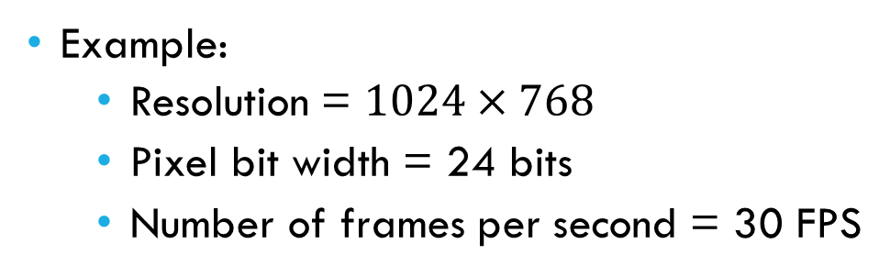

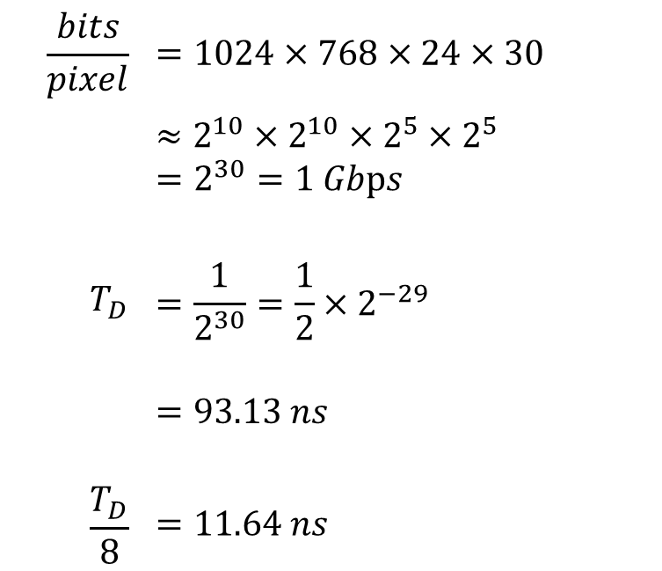
Example Of Setup Time Required
Example:
Resolution = $1024×768$
Pixel bit width = 24 bits
Number of frames per second = 30 FPS
$$\frac{bits}{pixel}$$ | $$=1024×768×24×30$$
 | $$≈2^{10}×2^{10}×2^{5}×2^{5}$$ $$=2^{30}=1 Gbps$$
$$T_{D}$$ | $$=\frac{1}{2^{30}}=\frac{1}{2}×2^{−29}$$
 | $$=93.13 ns$$
$$\frac{T_{D}}{8}$$ | $$=11.64 ns$$
Hence, the setup time for a pixel to be displayed is $11.64 ns$.

Slide 4
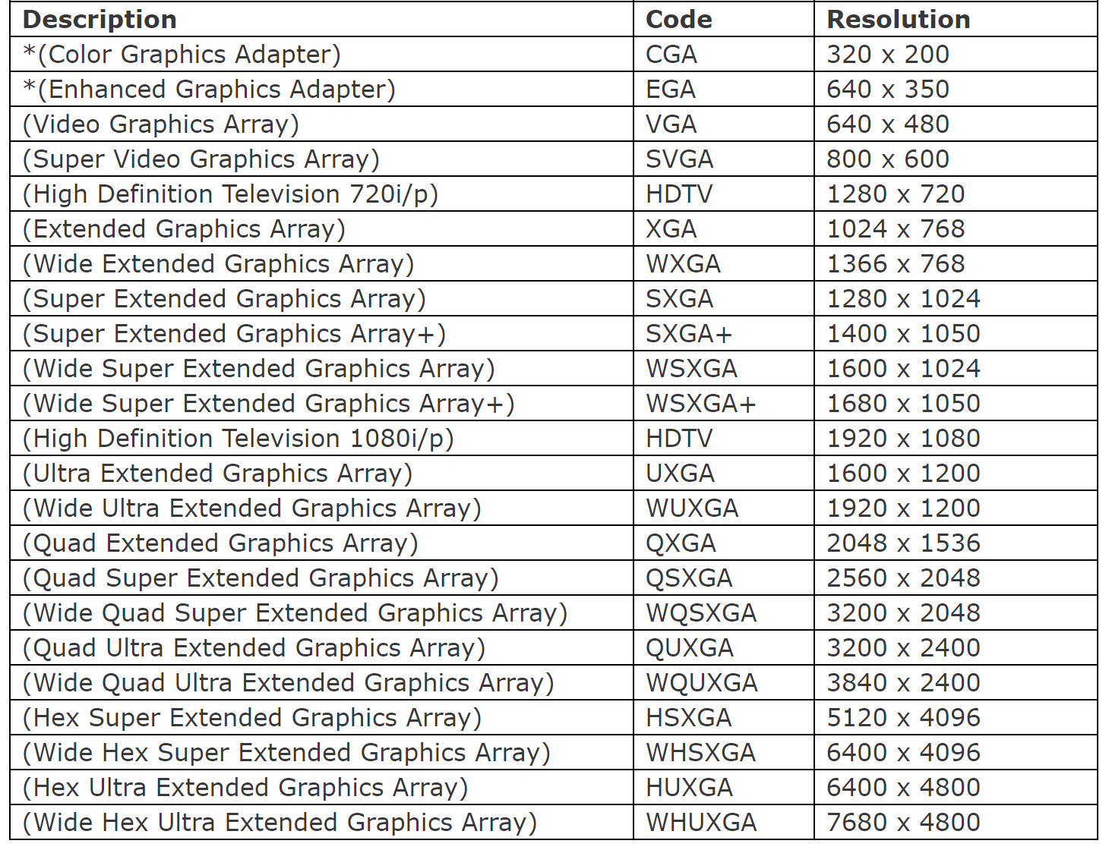
Industrial Standard
Table 1. List of standards and their resolutions
Video Streaming
1080p: 1920 x 1080
720p: 720 x 1080
Video Graphics Array (VGA)
VGA: 640 x 480
UXGA: 1600 x 1200
SXGA: 1280 x 1024
SVGA: 800 x 600
OV2640

Slide 5
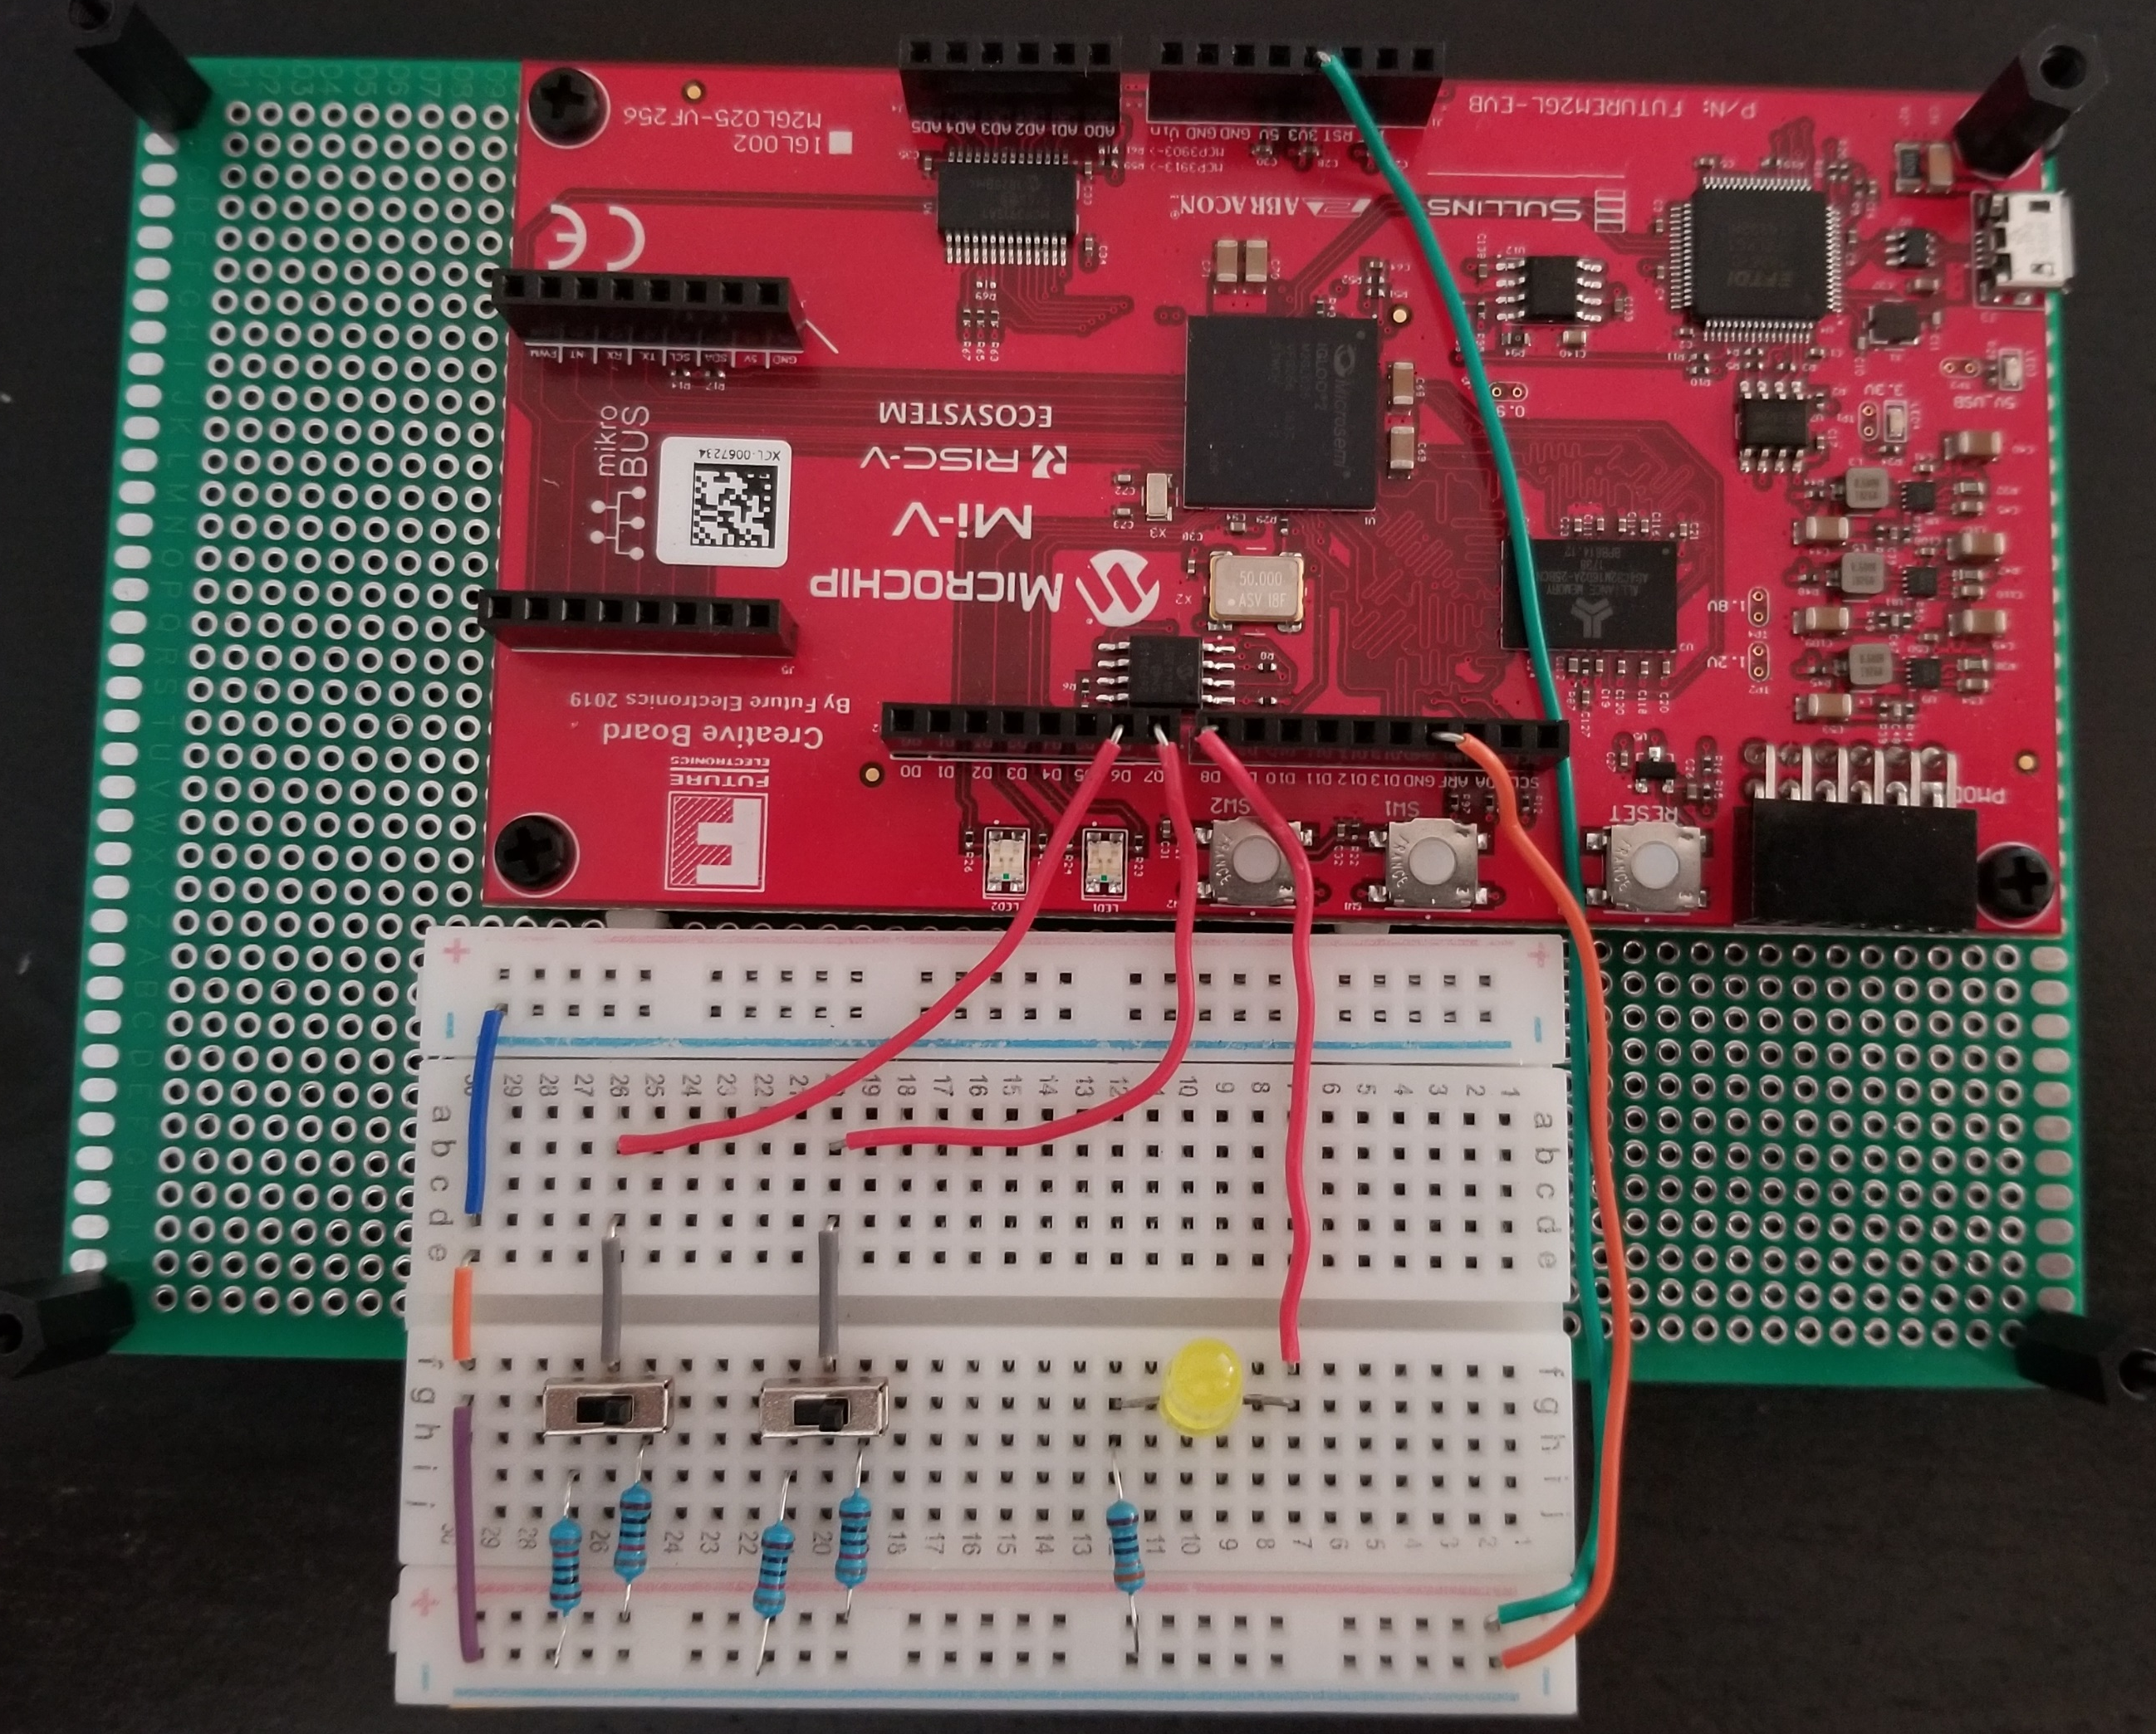
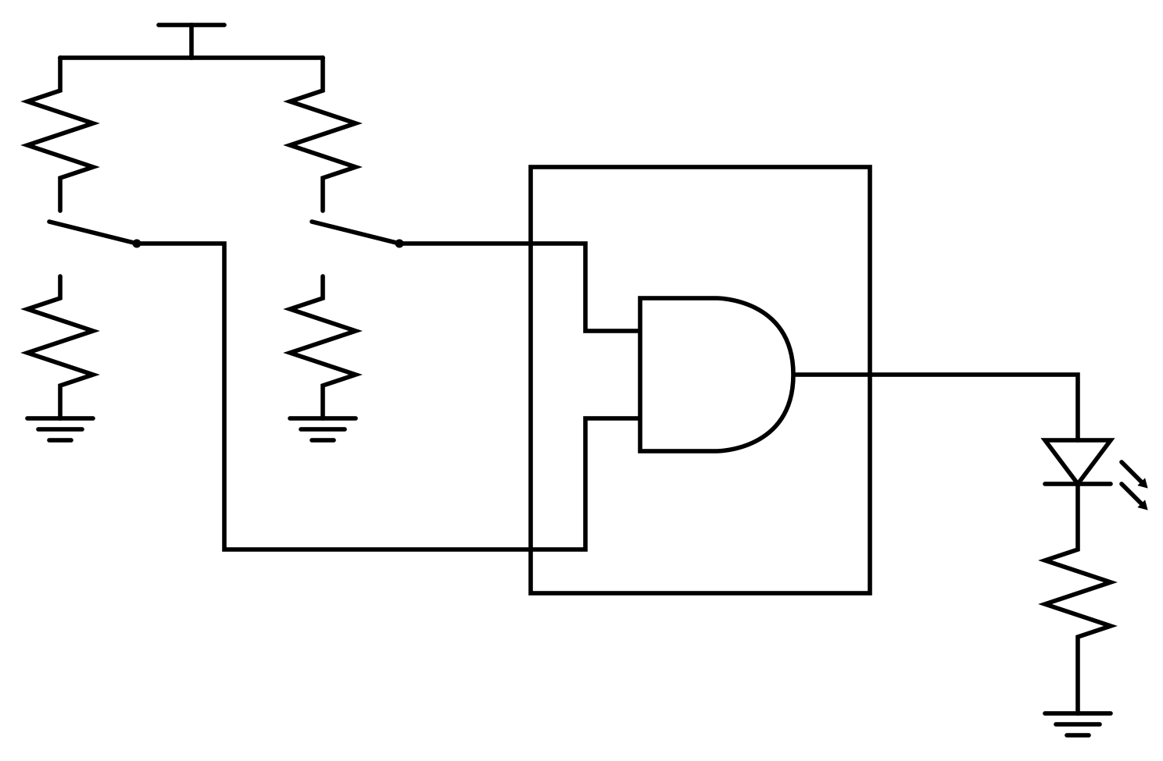
Objective
D7
3.3 V
D8
Determine the setup time for a logical AND gate
Test: Run a “Hello World!” by implementing an AND gate
Table 2. Port connections
AND | Pin
in1 | D6
in2 | D7
out | D8
GND
D6
3.3 V
825 Ω
825 Ω
4 mA
D7
825 Ω
825 Ω
in1
D8
4 mA
out
in2
FPGA
Fig. 5. Testing circuit connected to FPGA
4 mA
D6
325 Ω
Fig. 4. Testing circuit to light a LED

Slide 6
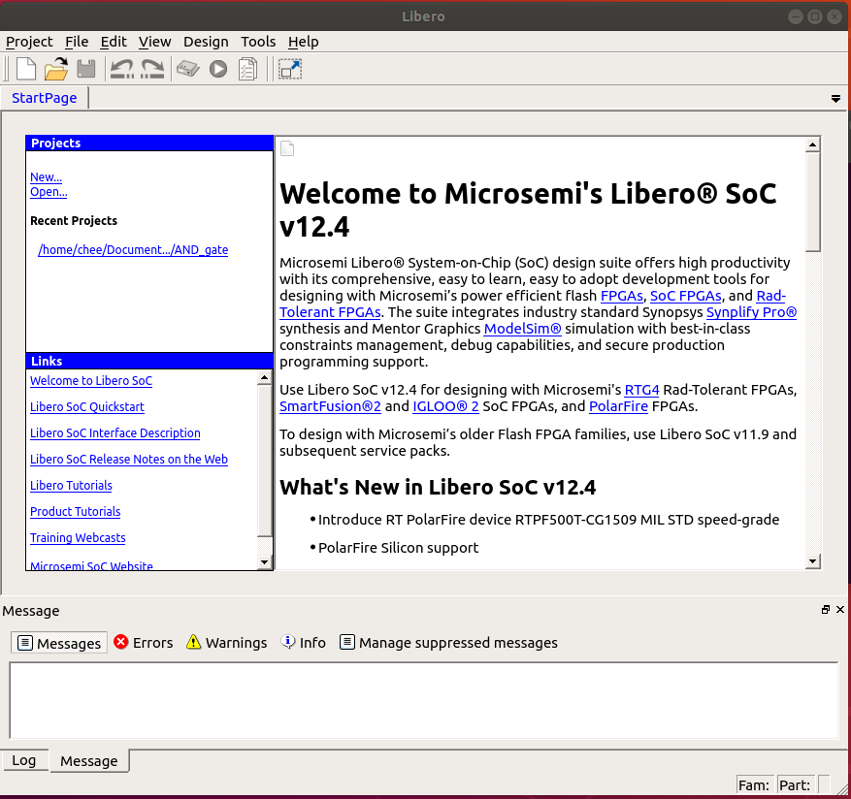
Step 1 Create New Project
4
Download and install Libero SoC v12.0 from https://www.microsemi.com/product-directory/design-resources/1750-libero-soc#downloads
Open Libero SoC IDE
Select New to create a new project
Alternative: Project > New Project
3
Fig. 6. Libero SoC v12.3 IDE

Slide 7
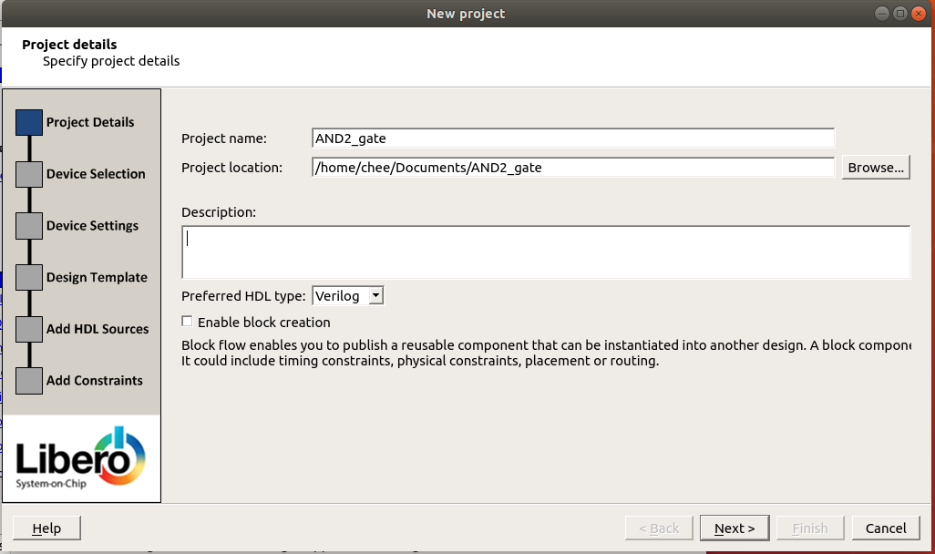
Step 2 Project Name & Location
Give a name to the project
Choose a location for the project by clicking on Browse
Make sure Preferred HDL type is Verilog
Click Next
5
6
7
8
Fig. 7. New Project window in Libero SoC

Slide 8
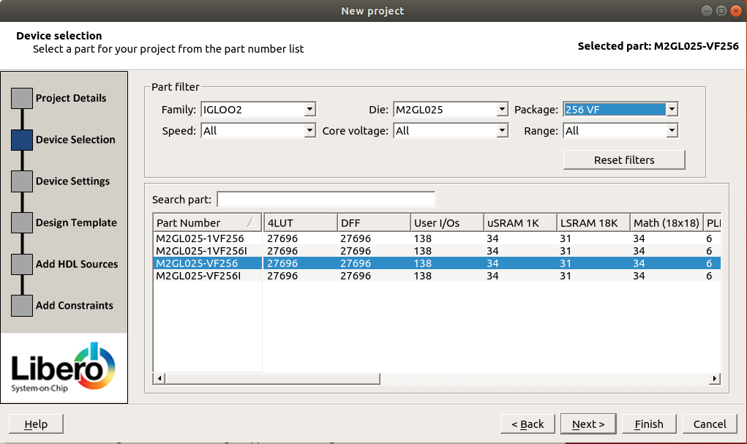
Step 3 Device Selection
Filter your selection
Family: IGLOO2
Die: M2GL025
Package: 256 VF
Select your board
Click on Next
9
10
11
Fig. 8. Device Selection

Slide 9
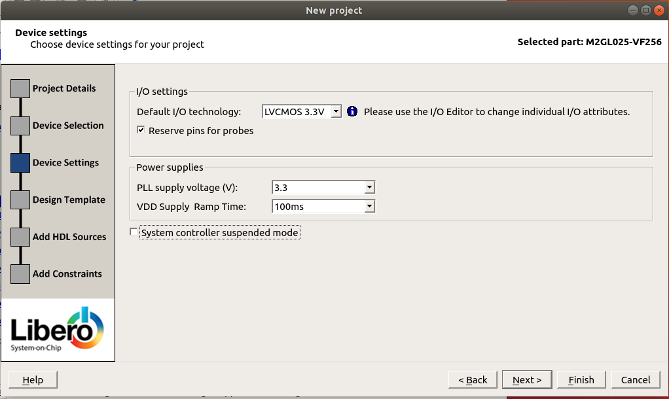
Step 4 Device Settings
Choose LVCMOS 3.3V for Default I/O Technology
Choose 3.3 for PLL supply voltage (V)
Click on Finish (since the next pages will be left as default)
12
13
14
Fig. 9. Device Settings

Slide 10
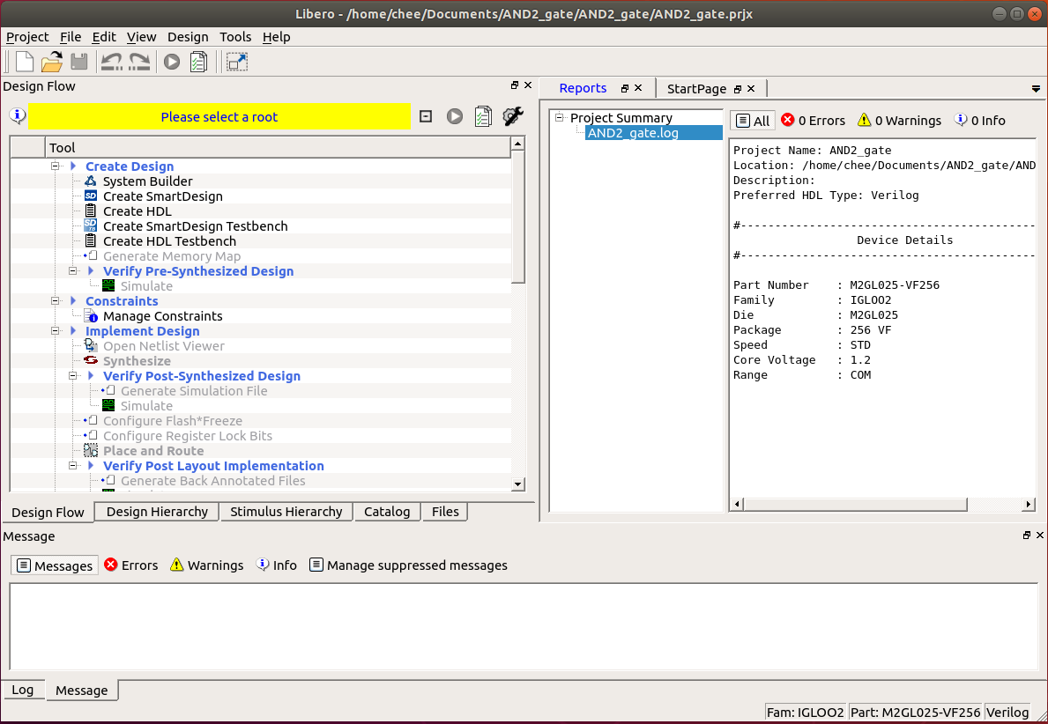
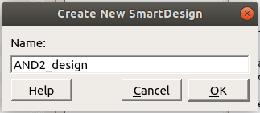
Step 5 Create New SmartDesign
In Design Flow, double-click on Create SmartDesign
In Create New SmartDesgin window, give a name to the SmartDesign
Click OK
15
16
17
Fig. 11. Naming the SmartDesign
Fig. 10. Creating a new SmartDesign

Slide 11
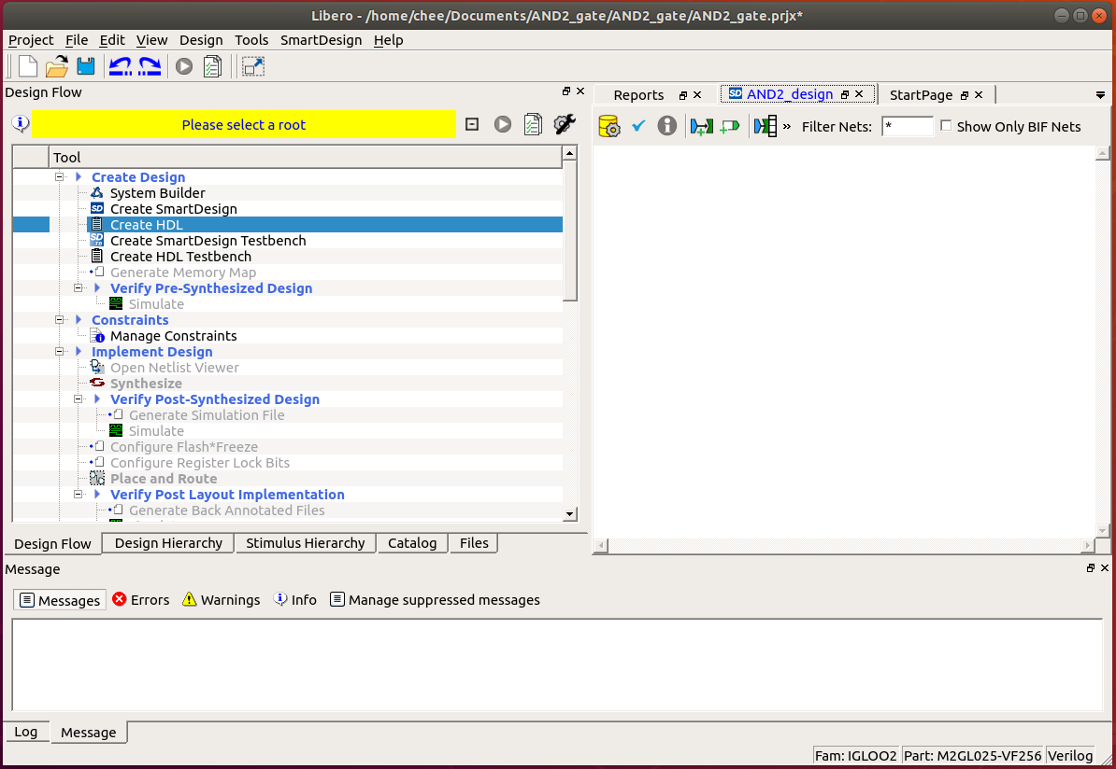
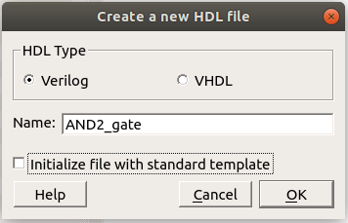
Step 6 Create HDL File
To create a Verilog file, double-click on Create HDL
Select Verilog for HDL Type
Give it a name
Uncheck Initialize file with standard template
Click OK
18
19
20
21
22
Fig. 13. Specifying the HDL type and name
Fig. 12. Creating a new HDL file

Slide 12
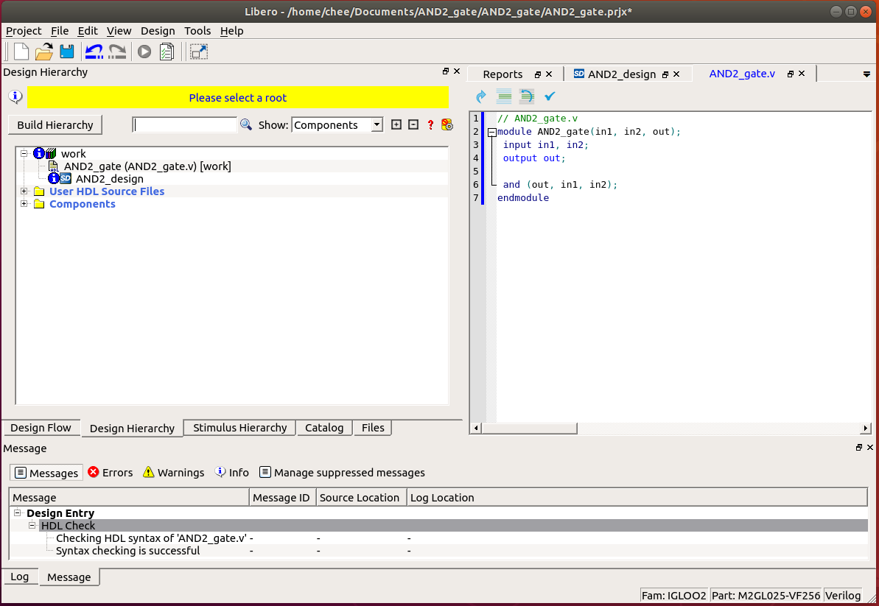
Step 7 Verilog Code and Verify AND Gate
In your Verilog file, enter
Click blue check to verify code
In Messages, syntax checking should be successful
Click Build Hierarchy for AND2_gate module to appear in Design Hierarchy
24
module AND2_gate(in1, in2, out);
input in1, in2;
output out;
and (out, in1, in2);
endmodule
25
23
Fig. 14. New Project window in Libero SoC

Slide 13
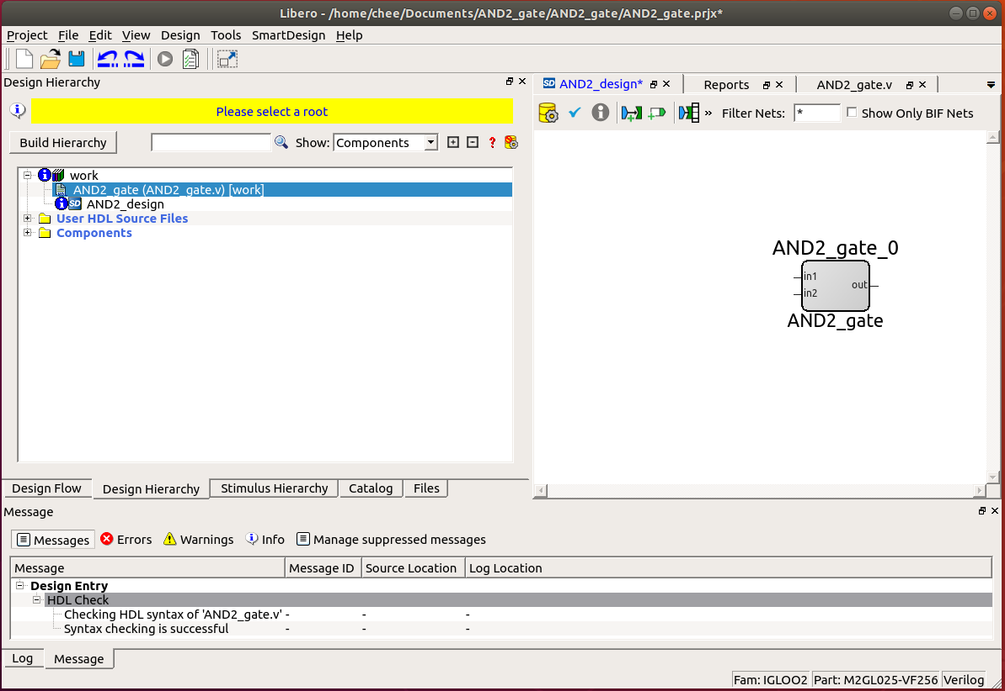
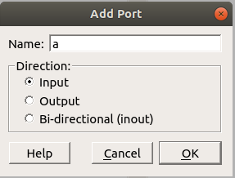
Step 8 Placing AND Gate and Ports in SmartDesign
Drag and drop and_gate module in work to the SmartDesign
Create input/output ports using Add Port button
In Add Port, enter a name
Select the direction
Click OK
27
26
28
29
30
Fig. 15. New Project window in Libero SoC
Fig. 16. Adding a port

Slide 14
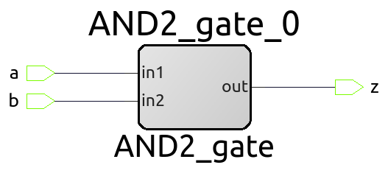
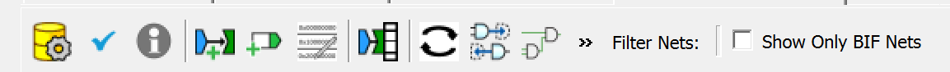
Step 9 Connecting ports To Module
Click on Connection Mode button
Connect input ports a and b to
Connect output port x to output
31
32
33
Fig. 17. SmartDesign toolbar
Fig. 18. Connections between the ports and AND2_gate module

Slide 15
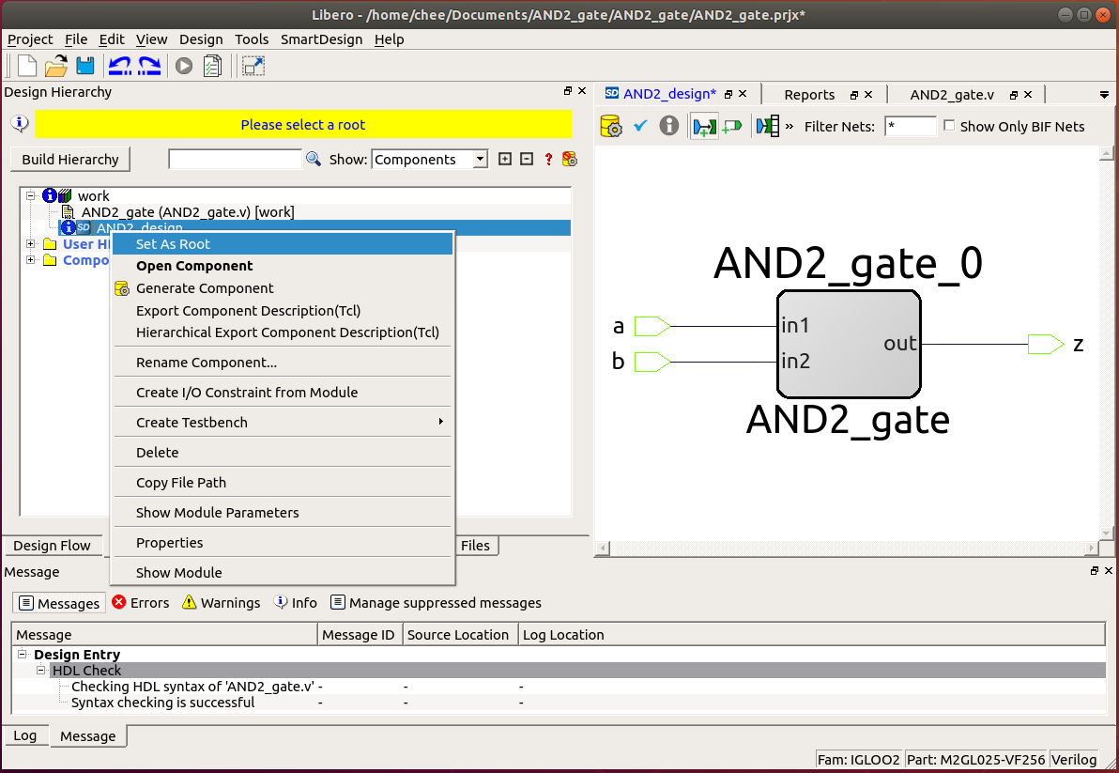
Step 10 Set SmartDesign as Root
Set the SmartDesign as root
Right-click on the SmartDesign
Choose Set As Root
34
Fig. 19. Setting the SmartDesign as root

Slide 16
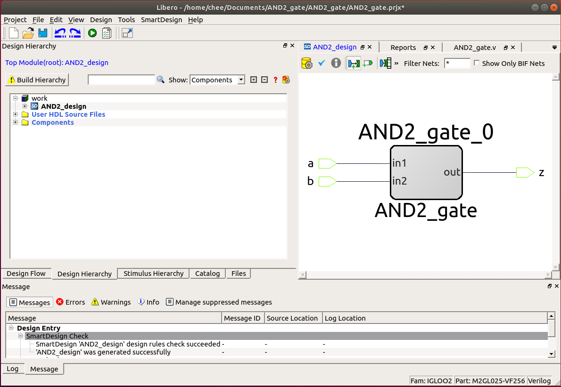
Step 11 Generate Component
Click on blue check to verify SmartDesign
Click on Generate Component
In Message window, it should say it was generated successfully
Click on Build Hierarchy again
37
36
35
Fig. 20. Placing AND2_gate module in SmartDesign

Slide 17
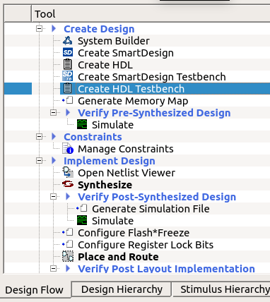
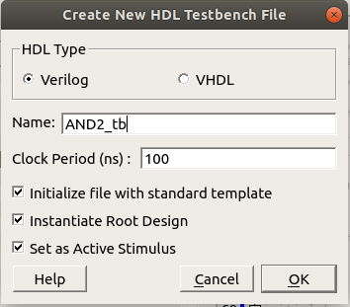
Step 12 Create a Testbench
In Design Flow, double-click on Create HDL Testbench
Select Verilog for HDL Type
Give testbench a name
Click OK
38
39
40
41
42
Fig. 22. Create New HDL Testbench File
Fig. 21. To create a new testbench
for the SmartDesign

Slide 18
Step 13 Modify Testbench
module AND2_tb; parameter SYSCLK_PERIOD = 100;// 10MHZ reg SYSCLK; reg NSYSRESET; reg sw1, sw2; wire LED; initial begin SYSCLK = 1'b0; NSYSRESET = 1'b0; end ///////////////////////////////////////// // Reset Pulse ///////////////////////////////////////// | initial begin #(SYSCLK_PERIOD * 10 ) NSYSRESET = 1'b1; end ////////////////////////////////////////// // Clock Driver ////////////////////////////////////////// always @(SYSCLK) #(SYSCLK_PERIOD / 2.0) SYSCLK <= !SYSCLK; ////////////////////////////////////////// // Instantiate Unit Under Test: AND2_design ////////////////////////////////////////// AND2_design AND2_design_0 ( | // Inputs .a(sw1), .b(sw2), // Outputs .z(LED) // Inouts ); initial begin sw1 = 0; sw2 = 0; #100 sw2 = 1; #100 sw1 = 1; #100 sw2 = 0; #100; $finish; end endmodule
Modify the testbench (in red) and verify (blue check)

Slide 19
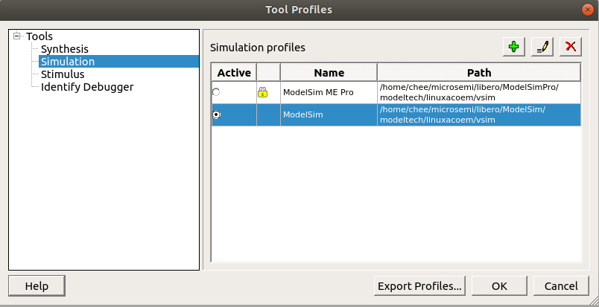
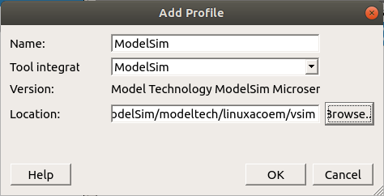
Step 14 Set ModelSim as Simulation Tool
Go to Project > Tool Profiles > Tools > Simulation
Select ModelSim (unlocked version) as Simulation Profile
If ModelSim (unlocked version) does not appear, click on Add Profile button.
Enter a name
Select ModelSim for Tool Integration
Browse to <location of libero>/ Modelsim/modeltech/linuxacoem/vsim
Click OK
Click OK
43
44a
44
45
Fig. 23. Selecting ModelSim as simulator in Tool Profiles
44b
44c
44d
44e
Fig. 24. Adding a simulation profile

Slide 20
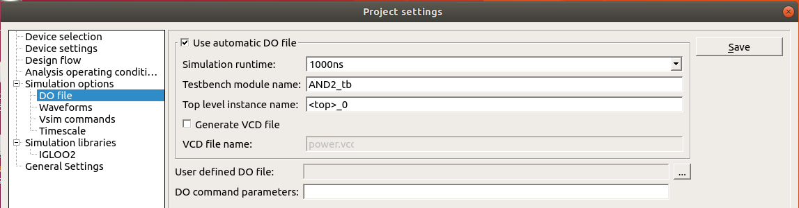
Step 15 Set Your Testbench In DO File
Go to Project > Project Settings > Simulation options > DO file
Enter the name of your testbench in Testbench module name
Click Save
Close out of Project Settings
47
48
46
Fig. 25. Adding a simulation profile

Slide 21
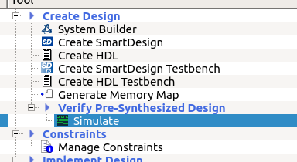
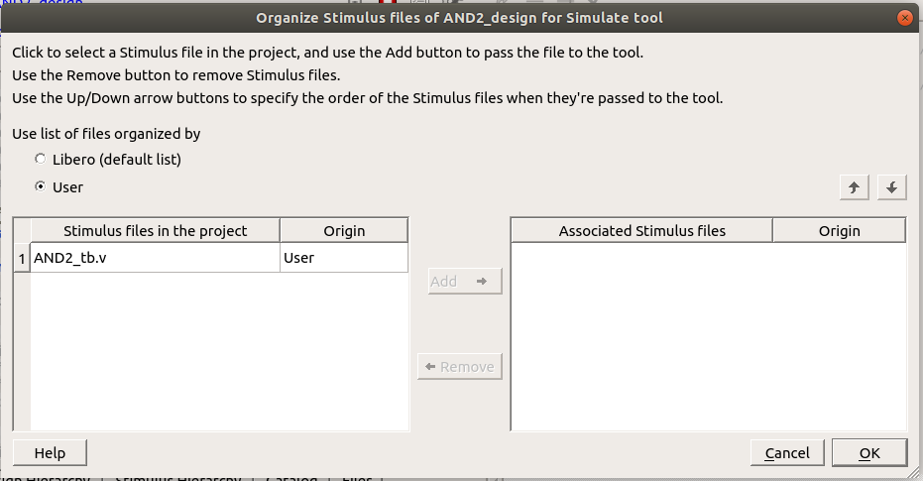
Step 16 Pre-Synthesis Simulation
In Design Flow, double-click Simulate under Verify Pre-Synthesized Design
Click Yes to associate a testbench
In the dialogue box, check User
Select your testbench and click on Add
Click OK
50
Fig. 26. Pre-synthesized Simulate
52
53
54
55
Fig. 27. Selecting associated testbench as stimulus

Slide 22
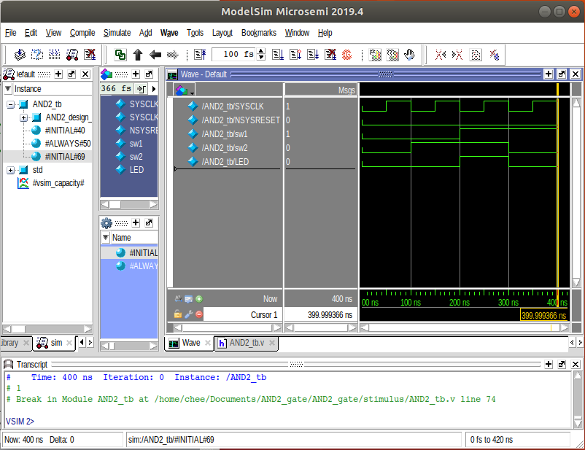
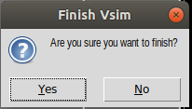
Step 17 Pre-Synthesis Simulation In ModelSim
In ModelSim, click No if asked to finish the simulation (otherwise, it will close). The signals will already be displayed.
Click on Wave window and press F to Zoom Full the waveform
Verify that the simulation is correct
Close ModelSim
55
Output (LED) is high only when both inputs (sw1 and sw2) are high
Fig. 28. Select No if asked to finish
Fig. 29. Simulation of AND2 gate on ModelSim

Slide 23
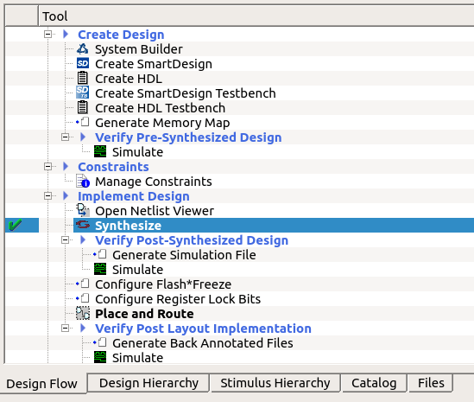
Step 18 Synthesize the SmartDesign
Go to Design Flow tab
Click on Synthesize
A green check mark will appear if successful
This must be done before assigning the pin constraints
59
58
Fig. 30. Synthesizing the SmartDesign

Slide 24
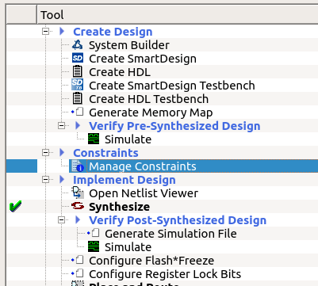
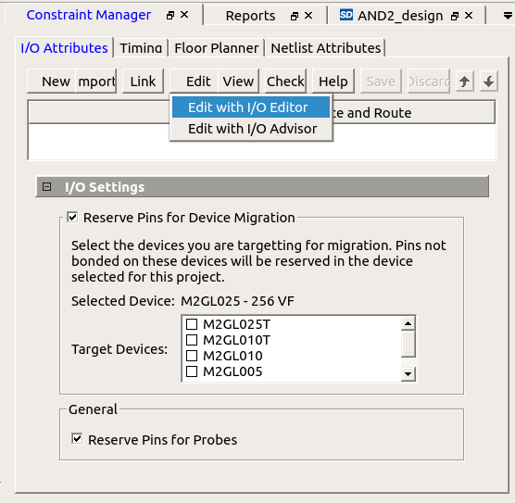
Step 19 Manage Constraints
61
62
60
Fig. 31. Manage Constraints in Design Flow
Click on Manage Constraints
In Constraint Manager, click on Edit
Choose Edit with I/O Editor
Fig. 32. I/O Editor in Constraint Manager Window

Slide 25
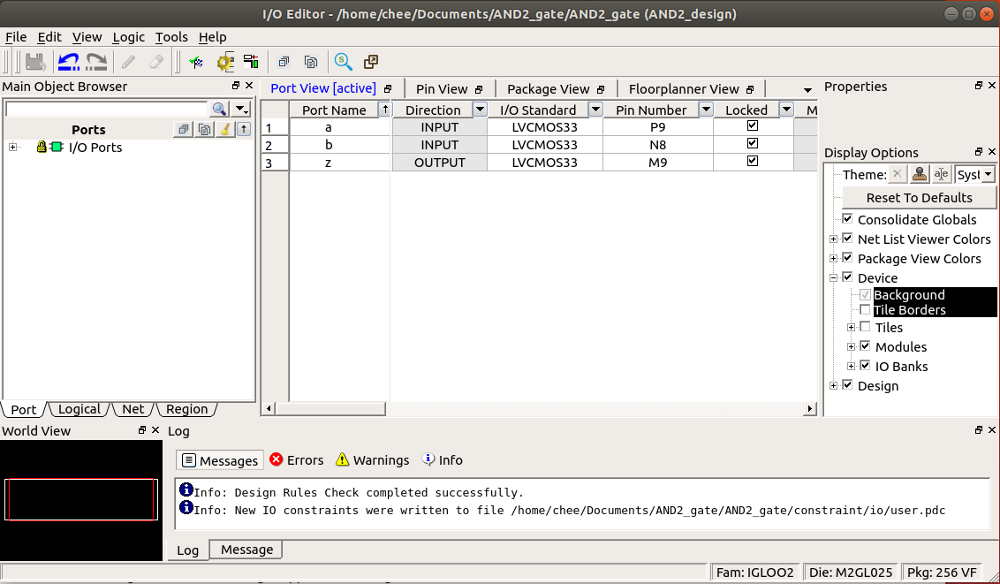
Step 20 I/O Editor: Pin Constraints
Assigns the pins as
Save the constraints by clicking on Commit button
It should say the design rules check was successful
64
Table 3. Connection between AND gate, SmartDesign ports, FPGA pin, and Arduino compatible connectors
 | Inputs |  | Output
AND2 | in1 | in2 | out
SmartDesign | a | b | z
FPGA Pin | P9 | N8 | M9
Pin Label | D7 | D6 | D8
63
Fig. 33. Assigning the pins in I/O Editor

Slide 26
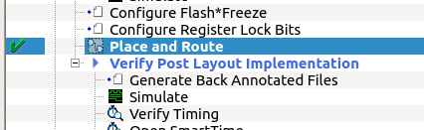
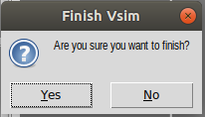
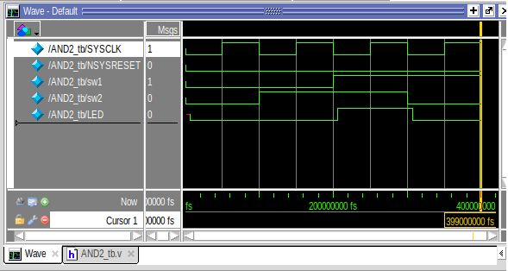
Step 21 Simulate after Place And Route
In Design Flow, double click on Place and Route
Double click Simulate under Verify Post Layout Implementation
Click on No in ModelSim if it asks to finish the simulation
Go to Wave window and press F to zoom full wave
Verify the output is correct
65
67
66
Fig. 35. Select No to finish
Fig. 34. Assigning the pins in I/O Editor
Output (LED) is high only when both inputs (sw1 and sw2) are high with delay
68
Fig. 36. Simulation of AND gate after Place and Route

Slide 27
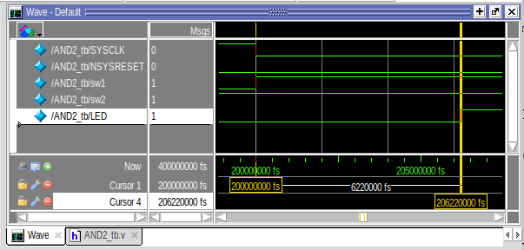
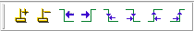
Step 22 Timing Delay of AND Gate
Zoom (I) on delay of output
Bring the cursor to 200 ns
Add a new cursor
If it doesn’t exit in the toolbar, right click toolbar and select Wave Cursor
Select output (LED) signal
Click on Find Next Rising Edge
Delay of AND gate is 6.22 ns
73
71
75
Fig. 37. Assigning the pins in I/O Editor
72
74
Fig. 38. Assigning the pins in I/O Editor

Slide 28
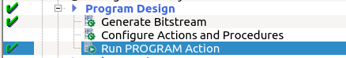
Step 23 Generate Bitstream and Run Program
Double-click Generate Bitstream
If successful, a green check will appear
Connect the testing circuit to FPGA
Double-click on Run PROGRAM Action to load the design into the FPGA
It is completed once the green check appears
Table 4. Corresponding connection between the AND gate and the FPGA pins
AND gate | Components | Pin Name
in1 | Switch 1 | D6
in2 | Switch 2 | D7
out | LED | D8
76
78
Fig. 40. Loading the design into FPGA

Slide 29
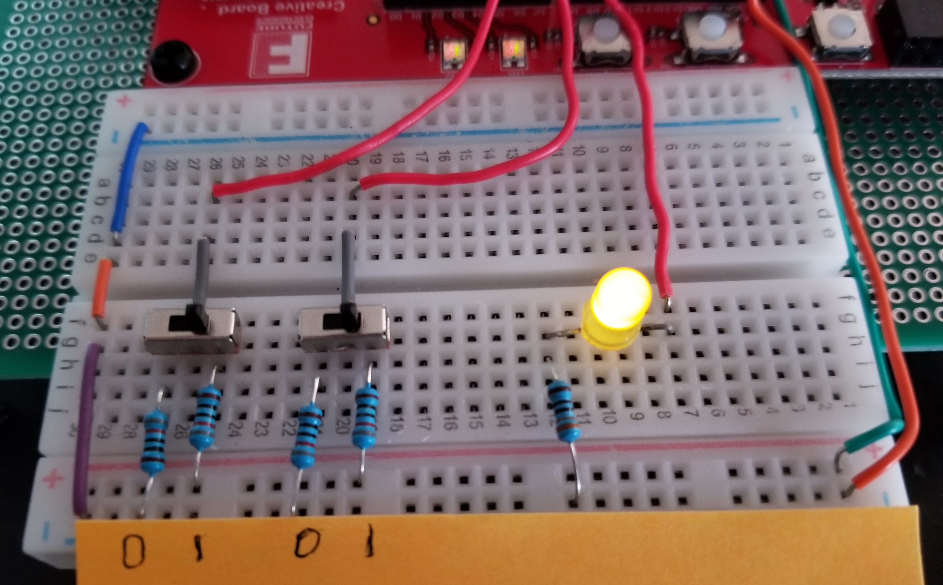
Step 25 Check Results in Physical Circuit
Fig. 41. Running the AND gate on the FPGA with the testing circuit where inputs are both high

Slide 30
Thank You!

